Slide 1
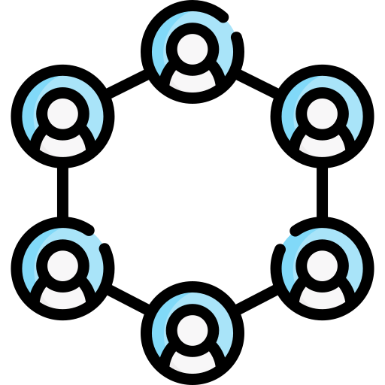
LOTTERY
DECENTRALIZED
Hai Nam Nguyen
Xuan Hieu Nguyen
Cong Chi Tai Nguyen

Slide 2
Problem Definition
Cyber-attacks, fraud, and manipulation
Security, transaction handling, data privacy, and user experience
Scalability, compliance, mitigating the impact of system failures and ensuring uninterrupted operations

Slide 3
Reasons Choose Blockchain
Transparency
Decentralization
Smart Contracts

Slide 4
Name Of The Contracts
Lottery
DataConsumerV3

Slide 5
Interfaces & Libraries
ILotteryDataInterface
IDataConsumerInterface
Chainlink Data Feeds

Slide 6
Functions
enter()
random()
pickWinner()
getPlayers()
pickPowerballWinner()
modifier restricted()
getEthToUsdRate()
convertToUsd()
getPowerballResult()

Slide 7
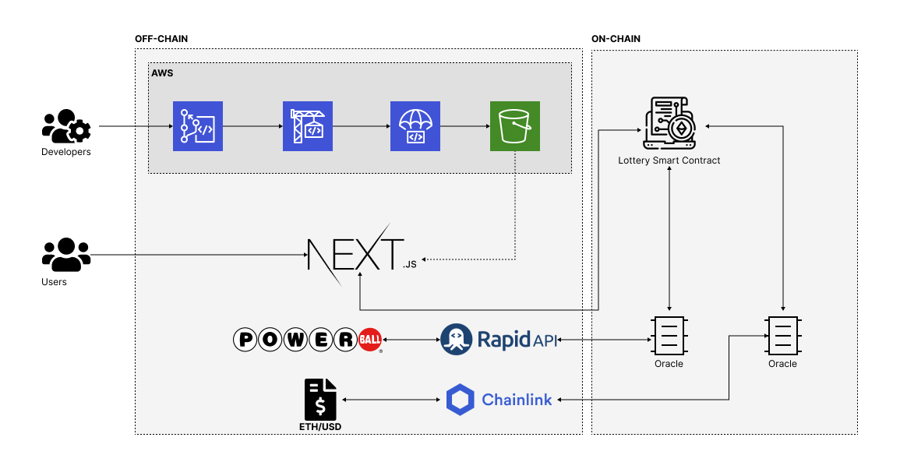
Architecture

Slide 8
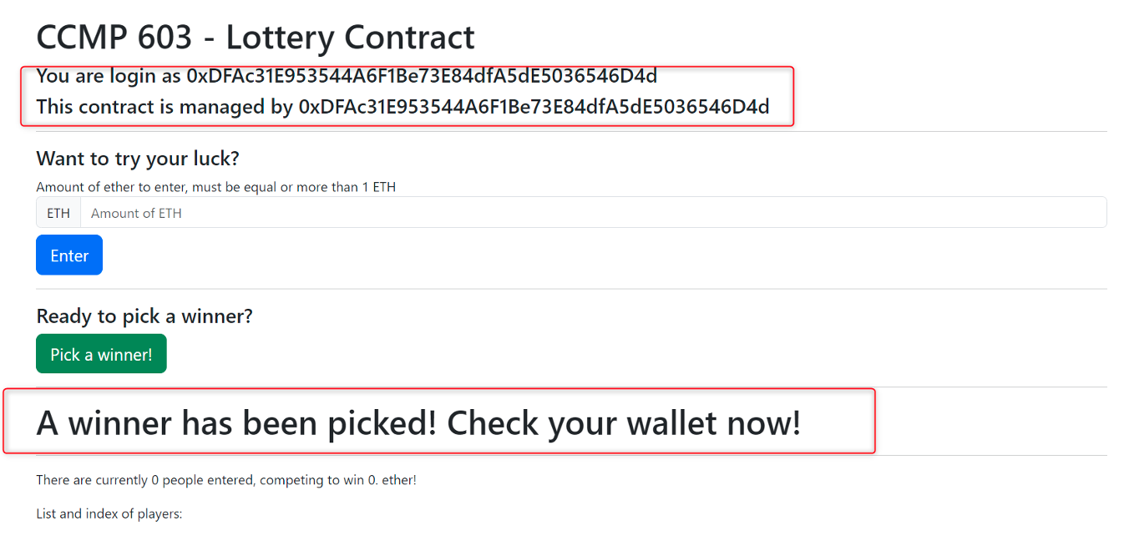
Front-end

Slide 9
THANK YOU FOR YOUR TIME
Q&A

